Slide 1

INBAR HILLEL
End-to-End Credit Card Transaction & Merchant Recommendation Analysis
Data Engineering, Modeling & BI Dashboarding on the Elo Merchants Dataset

Slide 2
Project Goals
Goals are threefold:
Executive Overview
Geographic Analysis
Category Profiles
Provide an executive overview of transaction activity and velocity over time, painting a clear picture of both past and new merchant transactions and installment behaviour
Identify key spending areas by finding the most active states and cities in terms of both transaction volume and average cardholder spending
Analysis of different merchant categories and subsectors across customer categories and profiles

Slide 3
Effect on Decision Making
Situational View
Targeting
Category Overview
The executive overview allows for examination of past transaction and comparison to newly-made transactions
Geographical analysis of customer behaviour will allow more efficient targeting of areas where market penetration is more likely
Analysis of activity across different merchant categories will allow determination of accurate identification of customer preferences

Slide 4
Handling Process
Manual Loading
Data Cleaning
Raw Data
Mirror
Staging
DWH Building
Dimension & Fact Tables
SQL Views
Power BI
STAR Schema Creation
Visual Demonstration

Slide 5
The Database
Merchant Category Recommendation
Historical Transactions
New Merchant Transactions
Merchants
All past transactions made are listed here, with details of amounts, dates, cards used, locations and merchant details.
20,000,000 rows.
All new transactions made are listed here, with details of amounts, dates, cards used, locations and merchant details.
1,963,031 rows.
Details all active merchants, listing details like ID, merchant category, average purchases/sales and anonymized categories (category, numerical).
334,696 rows.
Sample Submission
Train
Test
Contains Card ID and a “target” column.
123,623 rows.
Contains all card details (ID, first active month, installments etc.), as well as customer categories (labeled 1, 2 and 3).
201,917 rows.
Contains all card details (ID, first active month, installments etc.), as well as customer categories (labeled 1, 2 and 3).
123,623 rows.

Slide 6
Keys & Connections
Connected to view MRR.vs_GeographicSpending built from fact table MRR.FactTransactions
Tables | Connection Type MRR.vw_GeographicSpending → DimTable | Key Connections [Primary key] → [Foreign key]
MRR.DimMerchant | Many to One | merchant_id → merchant_id
MRR.DimDate | Many to One | FullDate → purchase_date
MRR.DimLocation | Many to One | city_id → city_id
MRR.DimMerchantCategories | Many to One | merchant_category_id → merchant_category_id
MRR.DimSubsector | Many to One | subsector_id → subsector_id
MRR.DimCard | Many to One | card_id → card_id

Slide 7
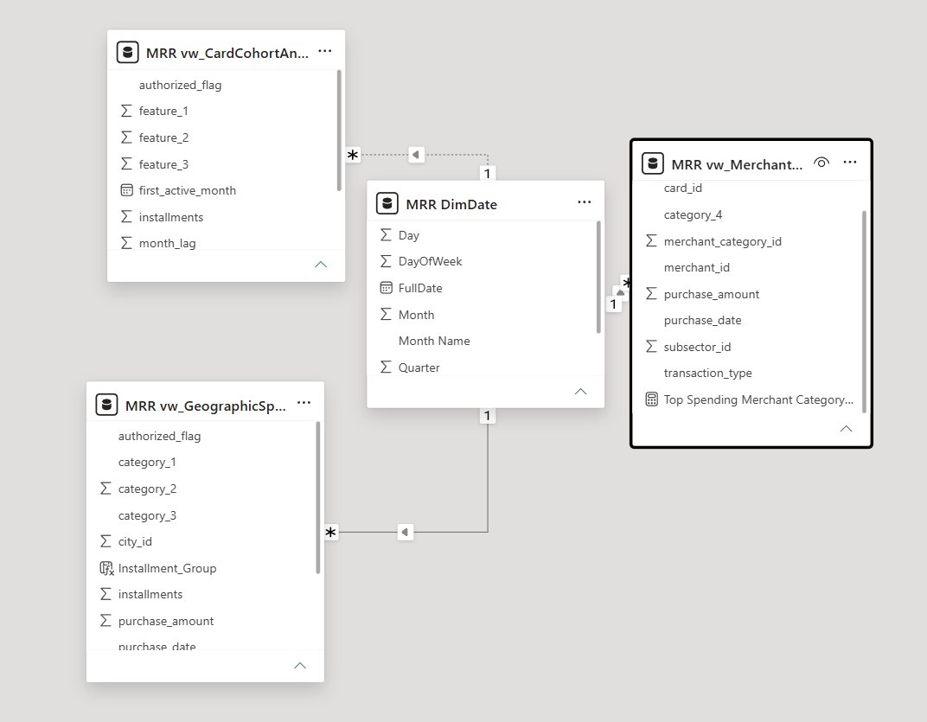
ERD Schema

Slide 8
Questions & Methodology
Category & Core Business Question | Business Importance | Analytical Tool & Method
Geographic Concentration Which states and cities generate the highest transaction volume and revenue? | Identifies regional market penetration, high-value territories, and expansion targets for local merchant partnerships. | SQL Views & Power BI: • Pre-aggregated in 3 different views • DAX TOPN & CONCATENATEX measures for top states • Matrix drill-down (state_id → city_id)
Merchant Category & Subsectors Which subsectors and niche merchant categories dominate total customer spend? | Uncovers category-wise spending patterns, guiding targeted merchant acquisition and partner discount programs. | SQL & Power BI: • Dimension modeling (DimSubsector, DimMerchantCategories) • Stacked bar charts and Top 10 category visualizations
Customer Behavior & Installments How do customers utilize installment payment plans across different card feature cohorts? | Assesses credit risk and payment preference trends, enabling tailored credit limits and installment promotions. | DAX & Power BI: • Custom Calculated Column with SWITCH(TRUE(), ...) for installment binning • Cohort slicing via feature_1, feature_2, feature_3
Historical vs. New Merchant Growth How does transaction velocity and volume shift when customers purchase at new vs. historical merchants? | Measures merchant network expansion, brand loyalty, and customer willingness to adopt new merchants. | ETL / SQL & DAX: • Unified FactTransactions with transaction_type indicator (Historical vs. New). • Time-series monthly spend line chart.

Slide 9
Analysis Workflow
Data Extraction & Aggregation (SQL)
Exploration & Modeling (Power BI)
Handled heavy data manipulation operations, deduplications and view aggregations in SQL Server to optimize memory efficiency.
Modeled star schema relationships (Many to One) and authored dynamic DAX measures for real-time interactive slicing and KPI tracking.

Slide 10
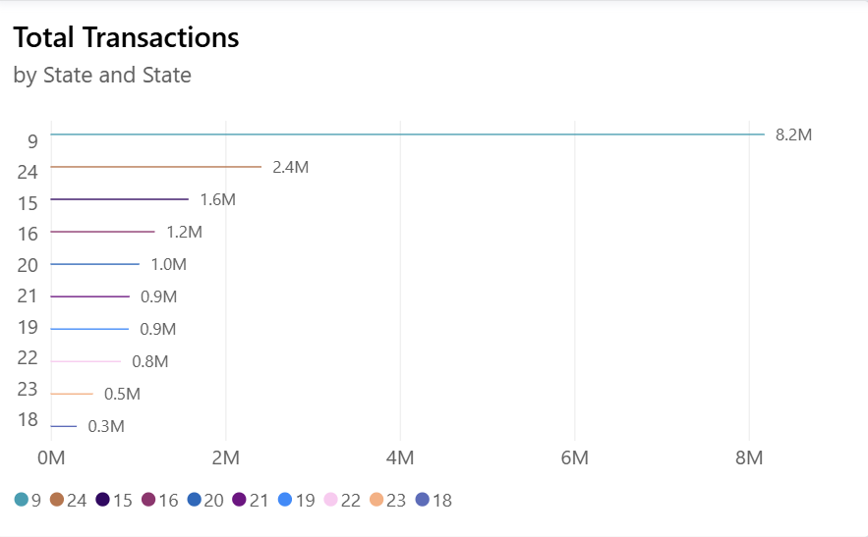
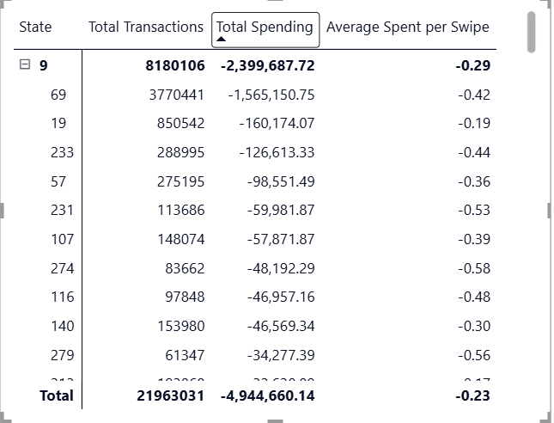
Business Insights
The most active state by transaction volume is state 9, which outpreforms every other state by a large margin with 8.2M transactions, which is roughly 4 times more than the second most active state, 24 (2.4M transactions). City 69 performs the best by far within State 9 (3,770,441 transactions). This suggests market penetration in state 9 is the most effective overall.

Slide 11
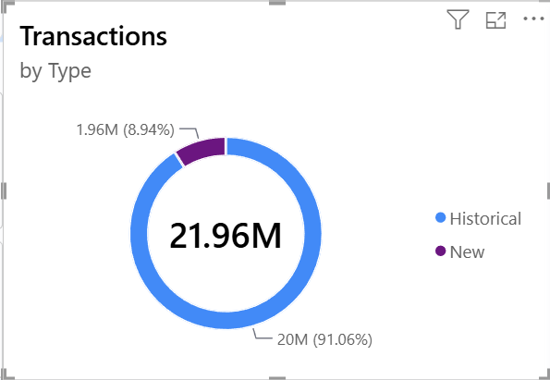
Business Insights
Out of 21.96M transactions, only 8.94% (1.96M) are newly listed. This is mainly because both amouts and volume for newly listed transactions has had a sharp increase between February and April of 2018, meaning there haven’t been much new transactions until recently.

Slide 12
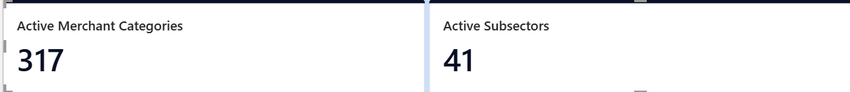
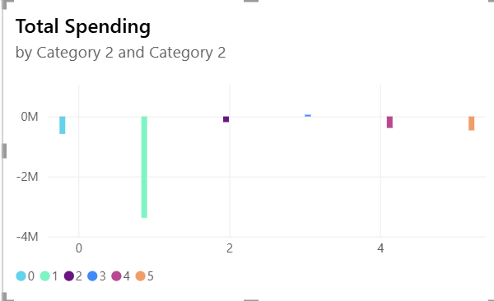
Business Insights
Number 1 in Category 2 is correlated with the most merchant categories, being active across most active merchant categories and business subsectors. It is also the most active of Category 2, with more than 3M in total spending. This suggests Number 1 is the most prevalent characteristic amongst customers in regards to Category 2.

Slide 13
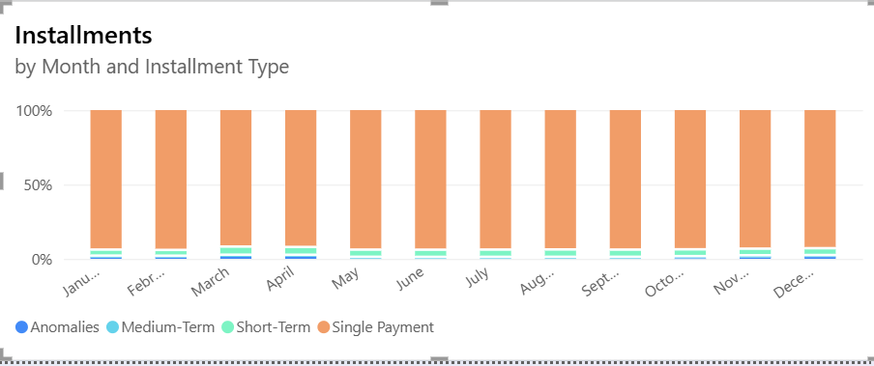
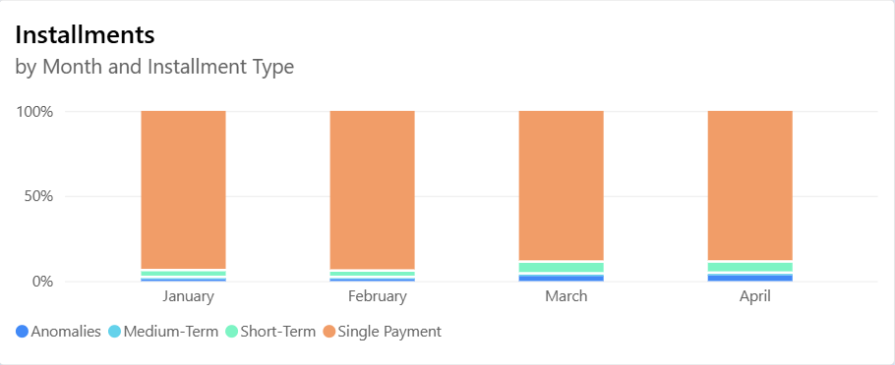
Business Insights
An overwhelming number of transactions (roughly 93%-94%) were made with a single installment, suggesting most custormers are not spending a very large amounts. This can be a result of a number of reasons, such as most customers making small private purchases rather than large business-related ones, or customers mostly paying for services rather than goods. A 5% dip in single-pay transactions can be seen in March and April of 2028, which could indicate increased business-related activity.

Slide 14
Dashboard Details
Core KPIs | Key Visuals & Metrics | Business Decision Support
Total Spend: Total purchase volume. | Time Trends: Monthly spend and transaction volume line chart | Partnership Strategy: Focuses loyalty perks and co-branding on top-performing merchant categories
Total Transactions: Overall transaction volume | Adoption Mix: Historical vs. New merchant volume split | Geographic Expansion: Targets marketing and merchant onboarding in high-volume cities
Average Spend per Card: Spend per unique cardholder | Installment Mix: Single payment vs. short/long-term installments | Credit & Risk Management: Aligns installment offerings with cardholder cohort behaviors
Authorization Rate (%): Approved vs. total attempts | Geographic Matrix: Regional drill-down (state_id → city_id)
Active Footprint: Distinct count of states, cities, and categories | Top Categories: Top 10 merchant categories by spend
Architecture Impact: Powered by an interactive 3-page Star Schema with SQL View pre-aggregations for instant cross-filtering and rapid drill-down.

Slide 15
Key Takeaways & Utilization
Spending Concentration:
A small subset of top states/cities (especially state no. 9) and core merchant subsectors accounts for the vast majority of total transaction revenue.
Adoption Velocity:
Cardholders expand into new merchant categories during specific seasonal windows, showing measurable shifts away from baseline historical categories.
Payment Preferences:
Installment utilization is heavily tied to specific high-ticket subsectors rather than general low-value daily purchases.
New Merchant Onboarding Incentives:
Offer introductory cashback or loyalty points when cardholders make their first purchase at newly partnered merchants to accelerate customer adoption beyond historical stores.
Targeted Merchant Partnerships:
Focus loyalty reward deals and co-branded discounts on top-grossing merchant categories to maximize card usage.
Localized Marketing & Expansion:
Allocate regional acquisition budgets and local merchant onboarding teams to high-volume urban clusters identified in the geographic matrix.

Slide 16
Challenges & Solutions
Dirty & Duplicate Records:
Raw tables contained duplicate entities and missing values -> Solution: Resolved key duplicates using SELECT DISTINCT and GROUP BY with MAX() aggregations, while imputing missing fields with 'Undefined' flags and column averages via SQL UPDATE statements.
Big Data Performance:
Loading millions of raw rows strained memory -> Solution: Built indexed SQL Views (vw_GeographicSpending, etc.) to offload heavy aggregations from Power BI to the database engine.
Model Integrity:
Avoided complex DAX calculations by structuring a strict One to Many Star Schema with a dedicated, conformed DimDate table.

Slide 17
Future Enhancements
Predictive Recommendation Engine:
Integrate Python/R to build machine learning models predicting merchant churn and recommending personalized merchant offers.
Automated Cloud ETL:
Migrate manual SQL loads to automated scheduled pipelines using tools like Azure Data Factory or SSIS.
Real-Time Streaming:
Ingest live transaction feeds to detect fraudulent authorization spikes in real time.

Slide 18

INBAR HILLEL
BORCELLE
  Thank
  you
BDO Academy Data Analyst Project

